Slide 1

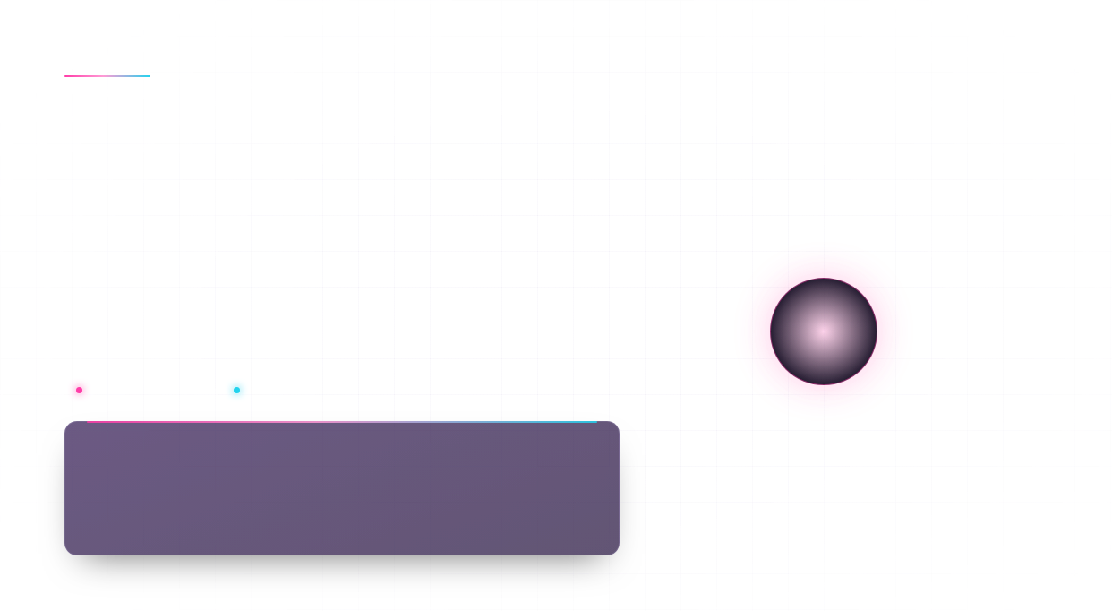

HAPPIEST HEALTH DIGITAL TWIN CHALLENGE 2026
01 / 12
TwinCare AI
Healthcare Digital Twin & Dynamic Telemetry Analytics
“Simulating physiological patterns. Exploring health scenarios.”
TC
SYNTHETIC PROTOTYPE
SIMULATED TELEMETRY
PARTICIPANT & SUBMISSION DETAILS · EDITABLE
PARTICIPANT NAME
COLLEGE
SUBMISSION DETAILS
Dhanushree
City Engineering College
Solo submission
VIRTUAL PATIENT · SYNTHETIC SIGNALS
SYNTHETIC DATA · SIMULATED OUTPUT
TwinCare AI · Hackathon prototype

Slide 2

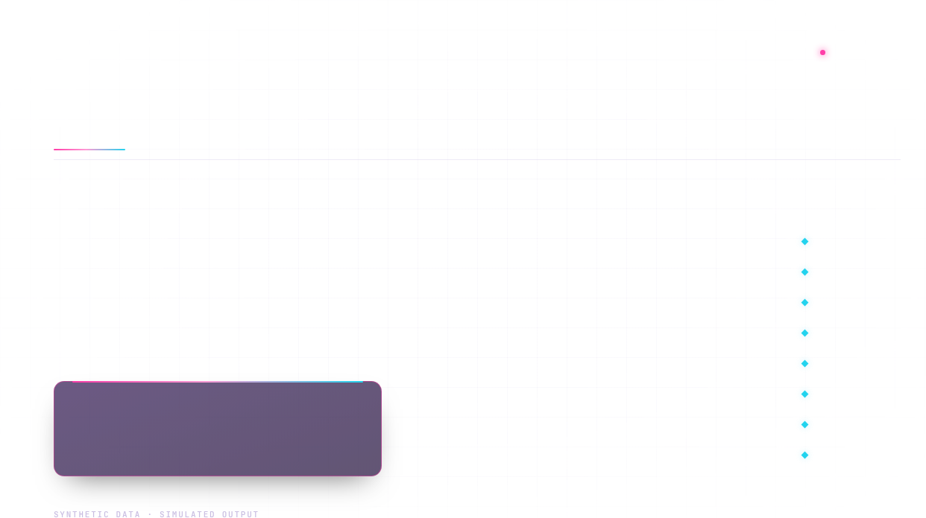
THE CHALLENGE
SIMULATED
The Challenge: Understanding Dynamic Physiological Patterns
01
CHANGING PATTERNS
EIGHT SIGNALS · SEPARATE MEASUREMENTS VS. UNIFIED PROTOTYPE VIEW
Difficulty in understanding changing physiological patterns over time.
UNIFIED PROTOTYPE
DOMAIN
SIGNAL
DISCONNECTED
Heart rate
Isolated reading
Shared time view
02
FRAGMENTED DATA
CARDIOVASCULAR
Challenge of integrating multiple, disconnected health measurements.
Blood pressure
Isolated reading
Shared time view
Glucose
Isolated reading
Shared time view
03
HIDDEN RELATIONSHIPS
METABOLIC & RESPIRATORY
Shared time view
Explaining relationships among heart rate, blood pressure, glucose, oxygen saturation, temperature, sleep, activity, and stress.
Oxygen saturation
Isolated reading
Temperature
Isolated reading
Shared time view
Sleep
Isolated reading
Shared time view
NEED
An interactive prototype to unify simulated health signals in one view.
LIFESTYLE & STATE
Activity
Isolated reading
Shared time view
Stress
Isolated reading
Shared time view
There is a need for an interactive environment that brings multiple simulated physiological signals together to support exploration of their patterns and relationships over time.
02 / 12

Slide 3


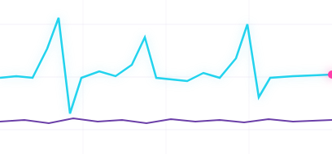
OUR SOLUTION
Our Solution: TwinCare AI —An Interactive Healthcare Digital Twin
An interactive prototype that models a virtual patient's physiological telemetry using synthetic data, presented in one unified dashboard.
NO.
FOCUS
KEY POINT
VIRTUAL PATIENT · TELEMETRY
SIMULATED
Introduction to TwinCare AI as an interactive healthcare digital twin prototype
01
PROTOTYPE
Models a virtual patient's physiological telemetry using synthetic data
02
VIRTUAL PATIENT
Enables users to configure virtual patients and inspect time-series signals
03
CONFIGURE & INSPECT
CONFIGURE
GENERATE
INSPECT
EXPLORE
04
Facilitates exploration of simulated scenarios and physiological patterns
SCENARIOS
Illustrative trace only. Synthetic telemetry generated by the prototype, not patient measurements.
05
Presents data through a unified, interactive dashboard
UNIFIED DASHBOARD
03 / 12

Slide 4
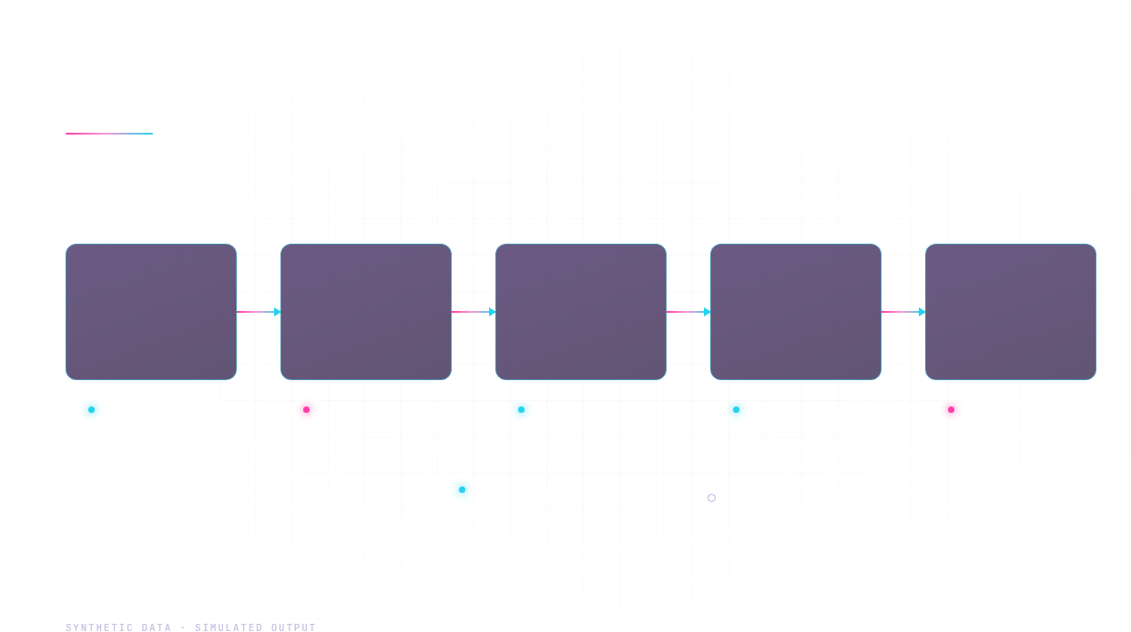

04 · CONCEPT
What is a Healthcare Digital Twin?
A healthcare digital twin is a computer model of one person's health profile that produces simulated measurements over time. TwinCare AI uses it to explore patterns and scenarios, as a prototype and not a clinically validated system.
HOW THE PARTS RELATE
01
02
03
04
05
Virtual patient profile
Simulated data
Computational analysis
Visualized patterns
Scenario exploration
Synthetic heart rate, BP, glucose, SpO2 and temperature telemetry
Patient identifier, age, biological sex, activity, sleep and stress settings
Data processing and feature preparation
Interactive physiological time-series charts
Changes to simulated parameters and anomaly controls, where implemented
IMPLEMENTED
SIMULATED
IMPLEMENTED
IMPLEMENTED
SIMULATED
PROTOTYPE VS. CLINICALLY VALIDATED DIGITAL TWIN
TWINCARE AI PROTOTYPE PROTOTYPE
CLINICALLY VALIDATED DIGITAL TWIN FUTURE SCOPE
DIMENSION
DATA SOURCE
Synthetic, simulated telemetry generated from configured patient settings
Measured patient data, validated against clinical evidence
PURPOSE
Interactive exploration of simulated scenarios and physiological patterns
Clinical use within a validated care pathway
04 / 12
VALIDATION
Not clinically validated
Requires clinical validation before any use
MEDICAL DECISIONS
Must not be used for real medical decisions
Clinical and privacy evaluation required before deployment

Slide 5

05 / 12 · DASHBOARD CAPABILITIES
Key Features of TwinCare AI
Core capabilities of the TwinCare AI dashboard, from virtual patient configuration to telemetry export.
NO.
CAPABILITY
DASHBOARD DETAIL
PATIENT CONFIGURATION INPUTS
Virtual patient configuration
Clinical cohort archetypes; patient identifier, age, biological sex, activity level, sleep duration and perceived stress settings
01
Patient identifier
Age
Biological sex
Activity level
Dynamic synthetic telemetry
Heart rate, blood pressure, blood glucose, oxygen saturation and temperature
Sleep duration
Perceived stress
02
Physiological time-series
Interactive physiological time-series charts; physiological stability and risk visualization
03
SYNTHETIC TELEMETRY SIGNALS
Heart rate
Blood pressure
Time and sensor controls
Telemetry time-horizon and sensor-interval controls
04
Blood glucose
SpO2
Anomaly and resimulation
Temperature
05
Acute anomaly simulation and telemetry resimulation, where implemented
Raw telemetry data export and presentation/architecture guide, where implemented
SCENARIO CONTROLS
06
Data export
Time horizon
Sensor interval
Anomaly simulation
Resimulation05 / 12
Raw data export

Slide 6

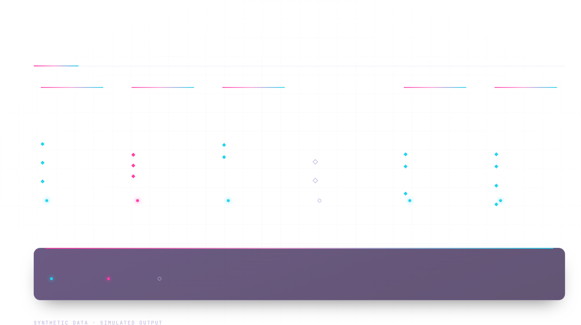
SYSTEM ARCHITECTURE · DATA FLOW
TwinCare AI System Architecture
Data moves left to right through six layers. Telemetry is simulated; one analytical layer remains future scope.
01
02
03
04
05
06
User inputs
Synthetic telemetry generation
Data processing
Analytical components
Trend & risk visualization
Streamlit dashboard
Virtual patient configuration layer
Feature preparation layer
Implemented analytical or ML components
Physiological trend and risk layer
User interaction interface
Patient identifier, age, biological sex
Generation layer
Pandas
Heart rate
NumPy
scikit-learn: not confirmed as used
Plotly
Streamlit
Activity, sleep, stress
Blood pressure
Interactive physiological time series
Dashboard overview
Clinical cohort archetypes
Glucose, SpO₂, temperature
Listed as future work until verified
Scenario and anomaly controls
Risk visualization
IMPLEMENTED
SIMULATED
IMPLEMENTED
FUTURE SCOPE
IMPLEMENTED
IMPLEMENTED
Resimulation, data export (where implemented)
STATUS KEY
DATA FLOW
SYNTHETIC TELEMETRY
IMPLEMENTED
SIMULATED
FUTURE
Solid arrows show data passing from one layer to the next. The dashed return path carries user scenario controls back to patient configuration.
Heart rate, blood pressure, glucose, SpO₂ and temperature are generated synthetically and labelled as simulated output.
06 / 12

Slide 7
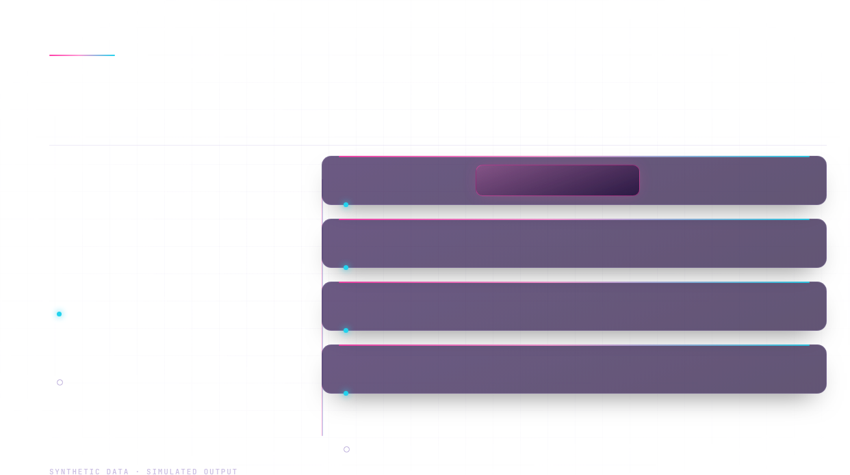
07 · BUILD STACK
Technology Stack
Languages, frameworks and libraries behind the TwinCare AI prototype, grouped by layer.
05
L1 · CORE
Core programming language
Python
CORE LANGUAGE
IMPLEMENTED
L2 · APP
Web application framework
Streamlit
DASHBOARD UI
NAMED TECHNOLOGIES · 5 LAYERS
IMPLEMENTED
L3 · DATA
Data manipulation and analysis
Pandas
NumPy
IMPLEMENTED
DATA MANIPULATION
NUMERICAL ANALYSIS
Python, Streamlit, Pandas, NumPy and Plotly are used in the project.
IMPLEMENTED
L4 · VIEW
Interactive visualizations
Plotly
FUTURE SCOPE
INTERACTIVE CHARTS
No ML library is confirmed in the brief. Add one only if it is present in the code.
IMPLEMENTED
L5 · ML
ML libraries
None confirmed in supplied brief
FUTURE SCOPE
LIST ONLY LIBRARIES PRESENT IN CODE
07 / 12

Slide 8

PRODUCT INTERFACE · DASHBOARD
IMPLEMENTED
Interactive TwinCare AI Dashboard
01
SCREENSHOT PLACEHOLDER
02
SCREENSHOT PLACEHOLDER
DASHBOARD OVERVIEW & VIRTUAL PATIENT PROFILE
LIVE TELEMETRY CARDS
Insert captured screenshot of the existing TwinCare AI interface
Insert captured screenshot of current vitals cards
Dashboard overview and virtual patient profile
Live telemetry cards
Main dashboard view with the virtual patient profile for a synthetic patient.
Current vital-sign readings shown as cards for the synthetic patient.
03
PLACEHOLDER
04
PLACEHOLDER
05
PLACEHOLDER
HEART RATE & BLOOD PRESSURE
GLUCOSE & SPO2
ACTIVITY VS. HEART RATE
Insert captured chart screenshot
Insert captured chart screenshot
Insert captured chart screenshot
Heart-rate and blood-pressure charts
Blood-glucose and oxygen-saturation visualizations
Activity versus heart-rate response chart
Interactive physiological time-series charts for the simulated telemetry.
Heart-rate response plotted against the simulated activity level.
Simulated glucose and SpO2 signals plotted over time.
SYNTHETIC DATA · SIMULATED OUTPUT
08 / 12

Slide 9
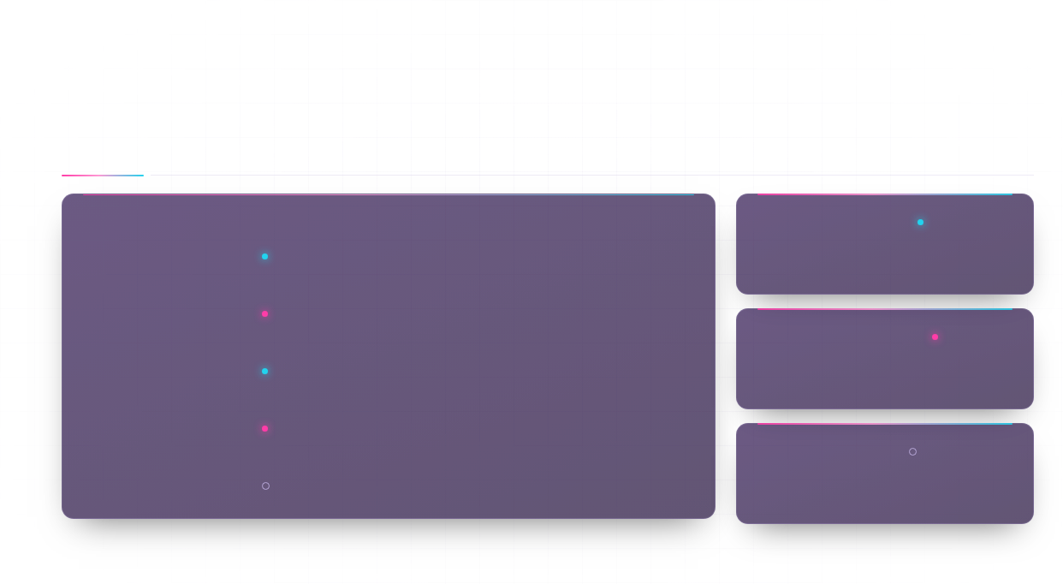
09 · ANALYTICS & SCENARIOS
Analytics and Scenario Exploration
Physiological signals displayed over time, with simulated patient parameters open to change. Visualization, simulation and prediction are kept distinct.
CAPABILITY
STATUS
WHAT THE PROTOTYPE DOES
VISUALIZATION
IMPLEMENTED
Interactive Plotly time-series of synthetic heart rate, blood pressure, glucose, SpO₂ and temperature.
Shows recorded signals
Signals over time
IMPLEMENTED
Plots the synthetic signals so patterns can be inspected over time.
Patient parameter changes
Age, biological sex, activity, sleep and stress settings change the synthetic telemetry stream.
SIMULATED
SIMULATION
SIMULATED
Pandas and NumPy feature preparation; trend and risk visualization rendered in Plotly.
Generates synthetic change
Analytical methods
IMPLEMENTED
Produces telemetry from configured virtual patient parameters. Not patient data.
Anomaly and resimulation
Acute anomaly simulation and telemetry resimulation, where implemented, on synthetic data only.
SIMULATED
PREDICTION
FUTURE SCOPE
Not measured. No model performance, prediction accuracy or validation metrics are reported.
Not claimed
Prediction accuracy
FUTURE SCOPE
No predictive accuracy is claimed. Evaluation on authorized, de-identified data is future work.
Disclosure: no predictive model performance has been measured. Figures on this slide are synthetic and are not for clinical use.
SYNTHETIC DATA · SIMULATED OUTPUT
09 / 12

Slide 10
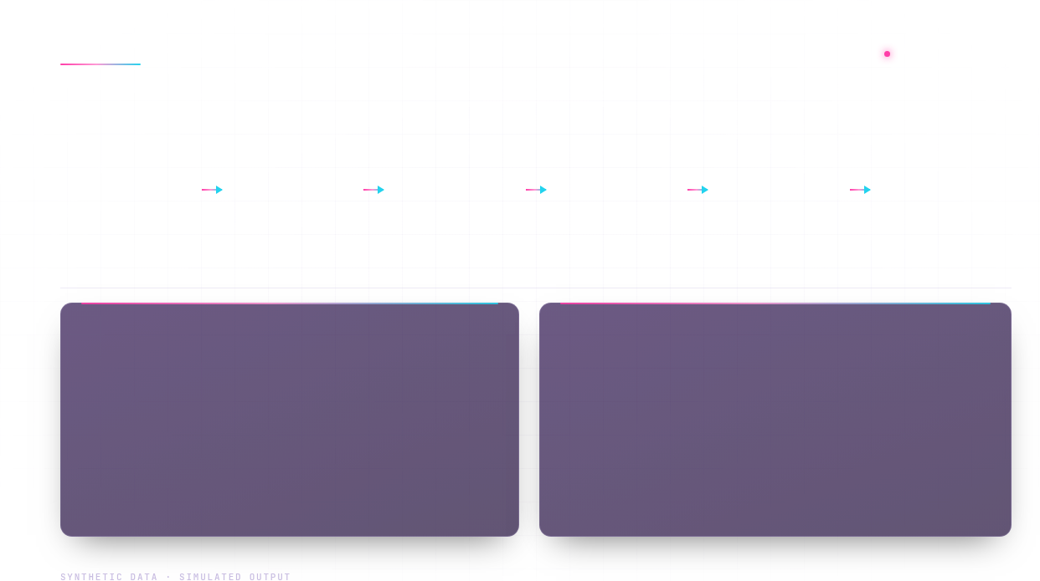
DEMONSTRATION WALKTHROUGH
SIMULATED DEMO
Demonstration Walkthrough & Key Observations
Six-step flow from selecting a virtual patient archetype to reviewing the displayed outputs.
STEP 01
STEP 02
STEP 03
STEP 04
STEP 05
STEP 06
Select a virtual patient archetype
Configure patient parameters
Inspect the generated telemetry stream
Explore time-series charts
Use supported scenario or anomaly controls
Review the displayed outputs
Screenshot placeholders
4 CAPTURES
Verified observations
Pending verification
SHOT 01 · ARCHETYPE SELECTION
SHOT 02 · PARAMETER CONFIGURATION
STEP
OBSERVATION
STATUS
STEP 01
[Placeholder: verified observation]
Pending
Placeholder for demo screenshot
Placeholder for demo screenshot
STEP 02
[Placeholder: verified observation]
Pending
SHOT 03 · TELEMETRY STREAM
SHOT 04 · TIME-SERIES CHARTS
Placeholder for demo screenshot
Placeholder for demo screenshot
STEP 03
[Placeholder: verified observation]
Pending
STEP 04
[Placeholder: verified observation]
Pending
[Placeholder: verified observation]
10 / 12
STEP 05
Pending
STEP 06
[Placeholder: verified observation]
Pending

Slide 11

11 / 12 · LIMITATIONS & SCOPE
Limitations, Safety & Future Scope
Limitations
4 ITEMS
Future scope
PROPOSED WORK
L1
Uses synthetic or simulated data for demonstration.
F1
Evaluate with appropriately authorized and de-identified real-world data.
L2
Is an experimental hackathon prototype.
F2
Improve temporal modeling and anomaly detection.
L3
Has not been established as a clinically validated diagnostic or prognostic system.
F3
Evaluate models using suitable validation metrics.
L4
Must not be used to make real medical decisions.
F4
Explore wearable-device integration.
F5
Conduct clinical and privacy evaluation before any real-world deployment.
SAFETY DISCLAIMER
Not clinically validated. Must not be used for real medical decisions.
SYNTHETIC DATA · SIMULATED OUTPUT
11 / 12

Slide 12
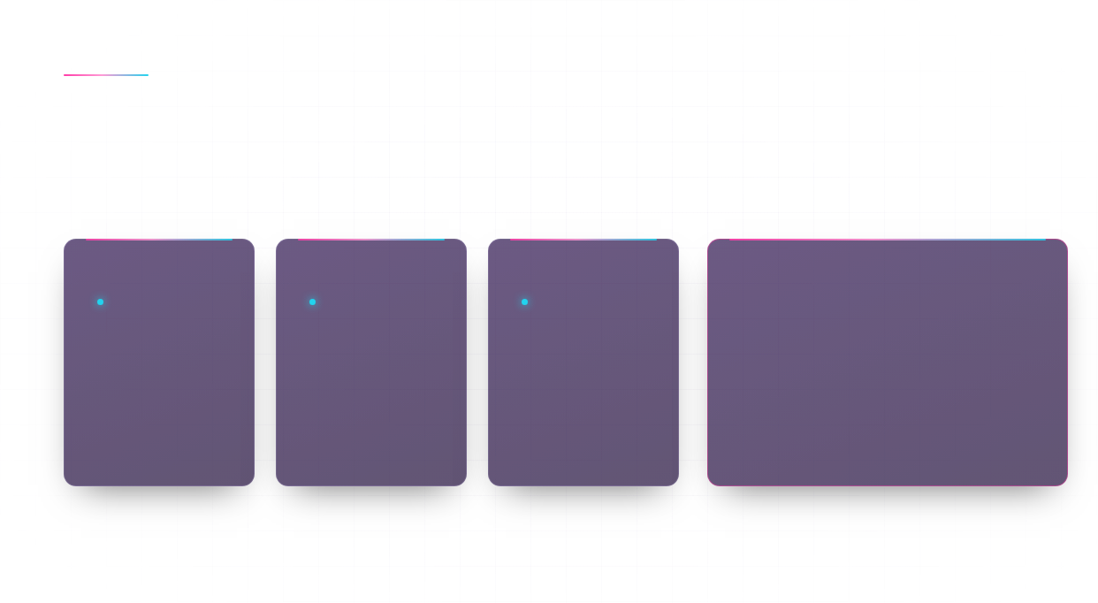
12 / 12 · CONCLUSION
Conclusion: TwinCare AI's Potential
TwinCare AI demonstrates an interactive approach to exploring synthetic physiological telemetry through virtual patient configuration, time-series visualization, and simulated scenario analysis.
ASPECT 01
ASPECT 02
ASPECT 03
POTENTIAL
IMPLEMENTED
IMPLEMENTED
IMPLEMENTED
Research and educational prototype
Virtual patient configuration
Simulated telemetry
Time-series visualization
TwinCare AI — Turning simulated health signals into meaningful exploration.
Clinical cohort archetypes with patient identifier, age, biological sex, activity, sleep and stress settings.
Dynamic synthetic telemetry for heart rate, blood pressure, glucose, SpO2 and temperature.
Interactive physiological time-series charts with time-horizon and sensor-interval controls.
Not a replacement for professional medical assessment.
EDITABLE PARTICIPANT AND COLLEGE DETAILS
PARTICIPANT NAME
COLLEGE
SUBMISSION DETAILS
Dhanushree
City Engineering College
Solo submission
SYNTHETIC DATA · SIMULATED OUTPUT
12 / 12

